Slide 1
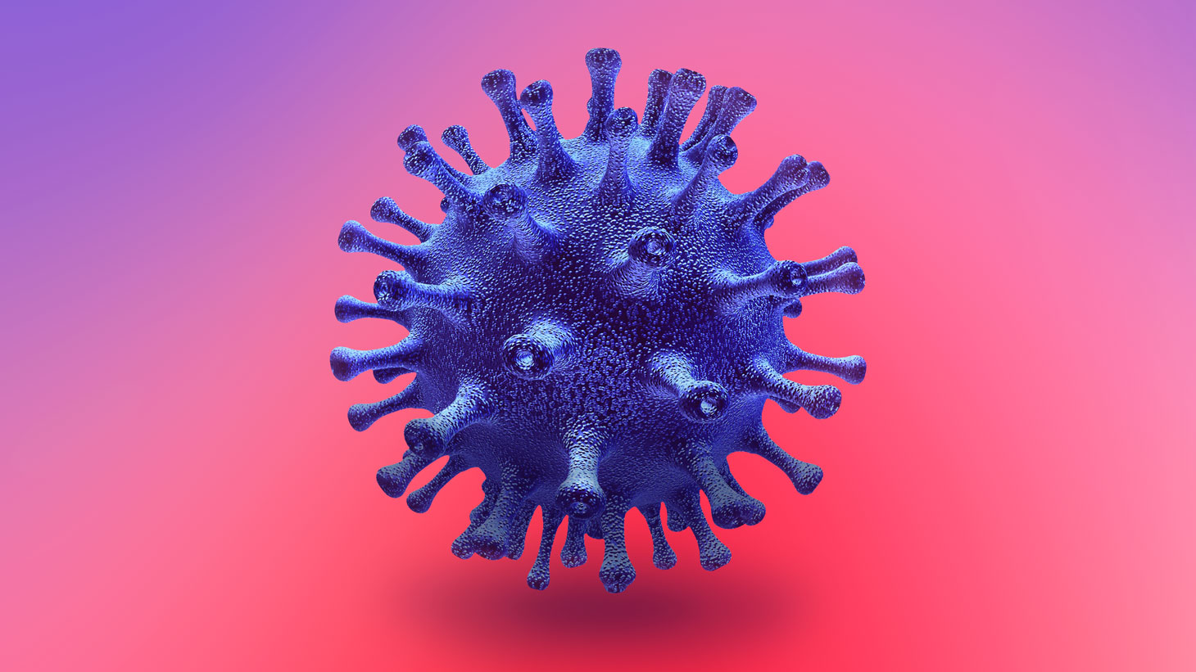
The Impact of PPE Education on Anxiety Levels Regarding COVID-19 Restrictions
By: Nicole Kim
Notes:
My name is Nicole Kim, and I am an Elmhurst University senior nursing student with the CASE Summer Fellows Program. Under the mentorship of Professor Laura Brennan, my research topic tests the impact of Personal Protective Equipment (also known as PPE) education on anxiety levels regarding COVID-19 restrictions in college students. Thank you for listening, and I hope you enjoy my presentation.

Slide 2
Purpose
The purpose of this study is to determine if education on the proper use of Personal Protective Equipment (PPE) reduces anxiety levels compared to no PPE education during quarantine.

Slide 3
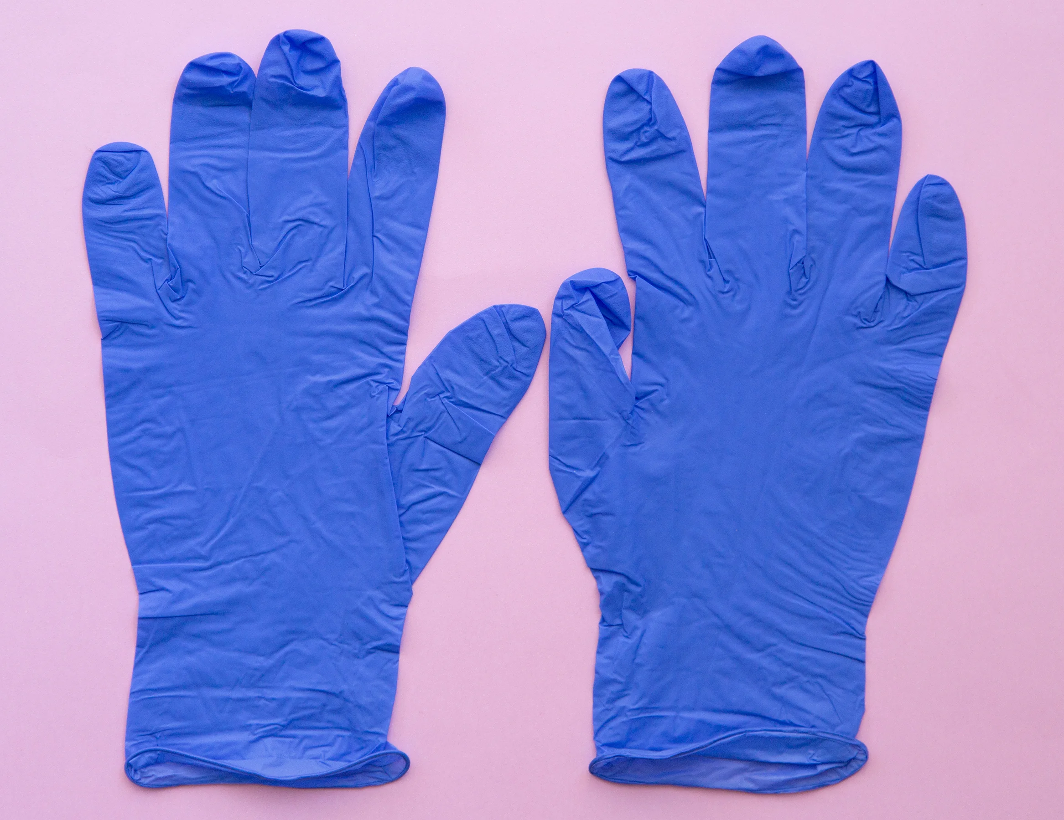
What is PPE? __
Personal Protective Equipment (PPE):
Gloves, face masks/shields, protective clothing, goggles, respirators, and other equipment used to help prevent exposure to infection or illness
https://www.glamour.com/story/should-we-be-wearing-gloves-for-coronavirus-protection-experts-explain
Notes:
So first off, what is PPE? PPE stands for… which includes…. Gloves, face masks etc

Slide 4
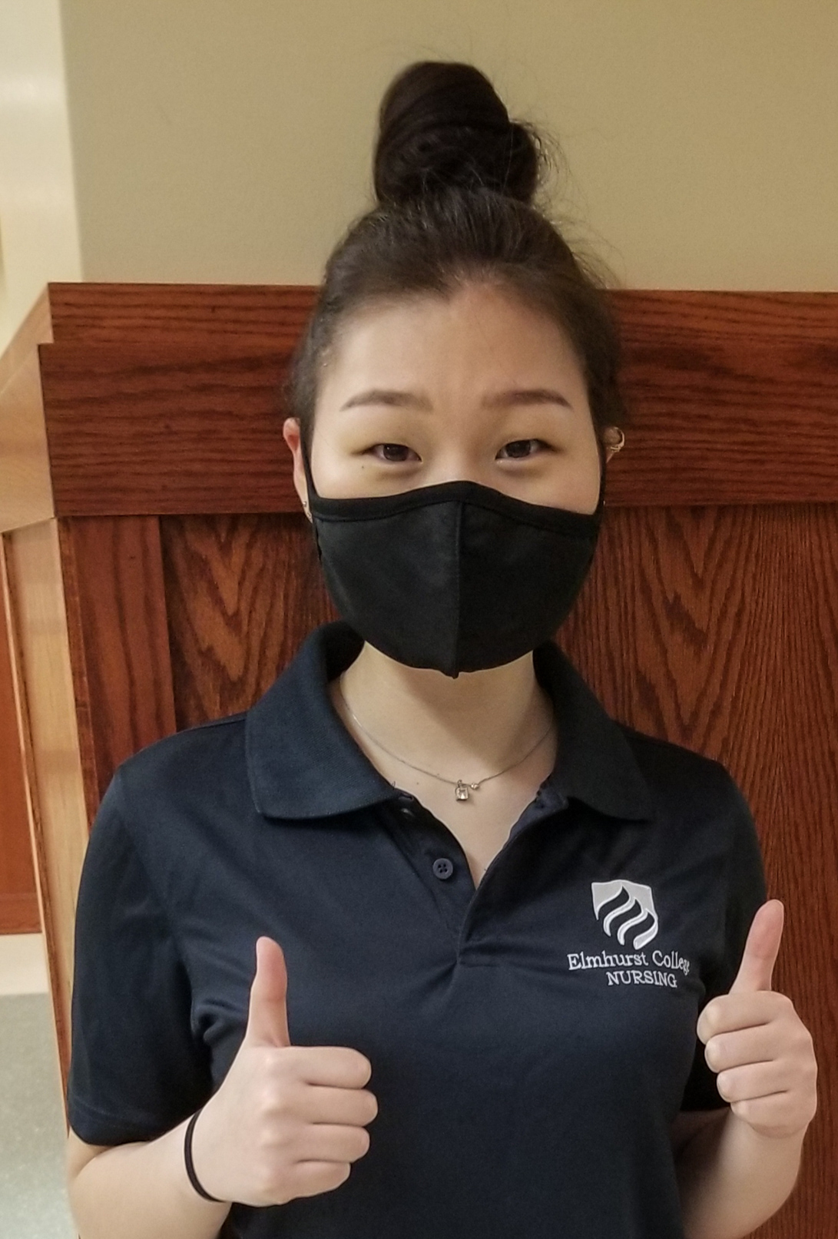
Hypothesis:
PPE knowledge does reduce anxiety levels regarding COVID-19 restrictions.

Slide 5
Population
Pre-nursing/nursing majors who have not yet taken a nursing course (incoming sophomore and junior pre-nursing/nursing students)
Total of 156 students, split into two groups of 78 each
All over 18 years of age
Participants will be recruited by sending out a mass email asking for volunteers
Notes:
The population I chose to study are… that includes
The reason why we chose nursing majors who have not yet taken a nursing course is because it would have been a limitation and create biased results had they already taken nursing courses that go over the importance and purpose of PPE.

Slide 6
methodology
Survey for Group A:
Survey for Group B:
Educational video
PPE knowledge quiz
Short version of State-Trait Anxiety Inventory (STAI) to assess anxiety levels
NO educational video
PPE knowledge quiz
Short version of State-Trait Anxiety Inventory (STAI) to assess anxiety levels
Notes:
The plan is to create 2 surveys. One survey is composed of an educational video, along with a PPE quiz and the State/Trait Anxiety Inventory (STAI) to assess anxiety levels afterwards. Participants will be randomly put into two groups; Group A and Group B. Group A will be asked to review an educational video on proper use of PPE, take a knowledge survey and the State-Trait Anxiety Inventory. Group B will take the knowledge video and the State-Trait Anxiety Inventory but no educational video.

Slide 7
Educational Video
https://youtu.be/PbNVyKjUpPs
Notes:
In this short educational video (which 3 min 45 seconds long), some of the stuff I talk about are how to properly put on PPE, the order in which it is most effective, and the different types of mask and which one would best fit for your situation.
The link is also provided in this slide for those who are interested in viewing it.

Slide 8
Six-item short-form version of STAI:
PPE Knowledge Quiz:
1.) What is the proper amount of time to wash hands with soap and water? | A.) 10 seconds B.) 20 seconds C.) 30 seconds
2.) Which type of mask should the general public wear? | A.) Cloth mask B.) Surgical mask C.) N95 mask
3.) How long does COVID-19 survive outside the body on surfaces? | A.) 30 minutes to one hour B.) Several hours to days C.) Up to two weeks
 | Not at all | Somewhat | Moderately | Very much
1. I feel calm | 1 | 2 | 3 | 4
2. I am tense | 1 | 2 | 3 | 4
3. I feel upset | 1 | 2 | 3 | 4
4. I am relaxed | 1 | 2 | 3 | 4
5. I feel content | 1 | 2 | 3 | 4
6. I am worried | 1 | 2 | 3 | 4
Notes:
I developed a 10-question PPE knowledge quiz on Qualtrics, basing the content off the CDC website. On the left of this slide are some examples of the type of questions that were asked, such as….. On the right side of this slide, the 6-item short-form version of the State/Trait Anxiety Inventory (STAI) [shown on the right] will be used To assess the students’ anxiety levels

Slide 9
Results
Research is ongoing
Recently received IRB approval and currently in the process of generating data
Educational video will be shown to Elmhurst University’s 2020 nursing orientation as well as posted on YouTube for the general public to see
Significance of this study is to educate and prepare students to continually practice disease prevention methods as they return back to campus
Notes:
By spreading education on COVID-19 restrictions as well as proper usage of PPE, we will become more equipped and prepared for future pandemics.

Slide 10
References
Centers for Disease Control and Prevention. (2020). Coronavirus (COVID-19). http://www.cdc.gov/COVID19
FDA. (2020, February 10). Personal Protective Equipment for Infection Control. https://www.fda.gov/medical-devices/general-hospital-devices-and-supplies/personal- protective-equipment-infection-control.
Honey-Roses, J., Anguelovski, I., Bohigas, J., Chireh, V. K., Mr., Daher, C., Konijnendijk, C., … Nieuwenhuijsen, M. (2020, April 21). The Impact of COVID-19 on Public Space: A Review of the Emerging Questions. https://doi.org/10.31219/osf.io/rf7xa
Kang, J., Kim, E. J., Choi, J. H., Hong, H. K., Han, S. H., Choi, I. S., Ryu, J. G., Kim, J., Kim, J. Y., & Park, E. S. (2018). Difficulties in using personal protective equipment: Training experiences with the 2015 outbreak of Middle East respiratory syndrome in Korea. American journal of infection control, 46(2), 235–237. https://doi.org/10.1016/j.ajic.2017.08.041
Notes:
This concludes the end of my presentation. Thank you for listening and stay safe!

